Slide 1
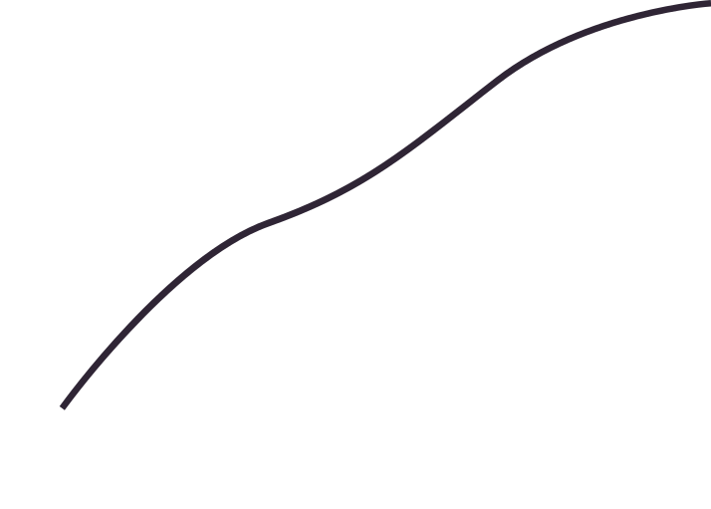

Team Python
COVID-19 & DATA SCIENCE
CIS 9650 Fall 2020

Slide 2

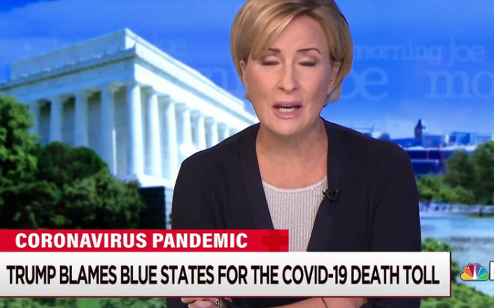


Covid is a topic on nearly every news station and website—all with different claims on its drivers and impact.
Steven Taylor, professor in psychiatry at the University of British Columbia, argues that “for an unfortunate minority of people, perhaps 10 to 15%, life will not return to normal”, due to the impact of the pandemic on their mental wellbeing. -BBC
American Psychology Association says, “The coronavirus pandemic is an epidemiological and psychological crisis.”
States with Democrats in power have controlled the spread of the coronavirus better than their Republican counterparts. -Newsobserver.com
Red states continue to be the most impacted – Brookings Institute

Slide 3
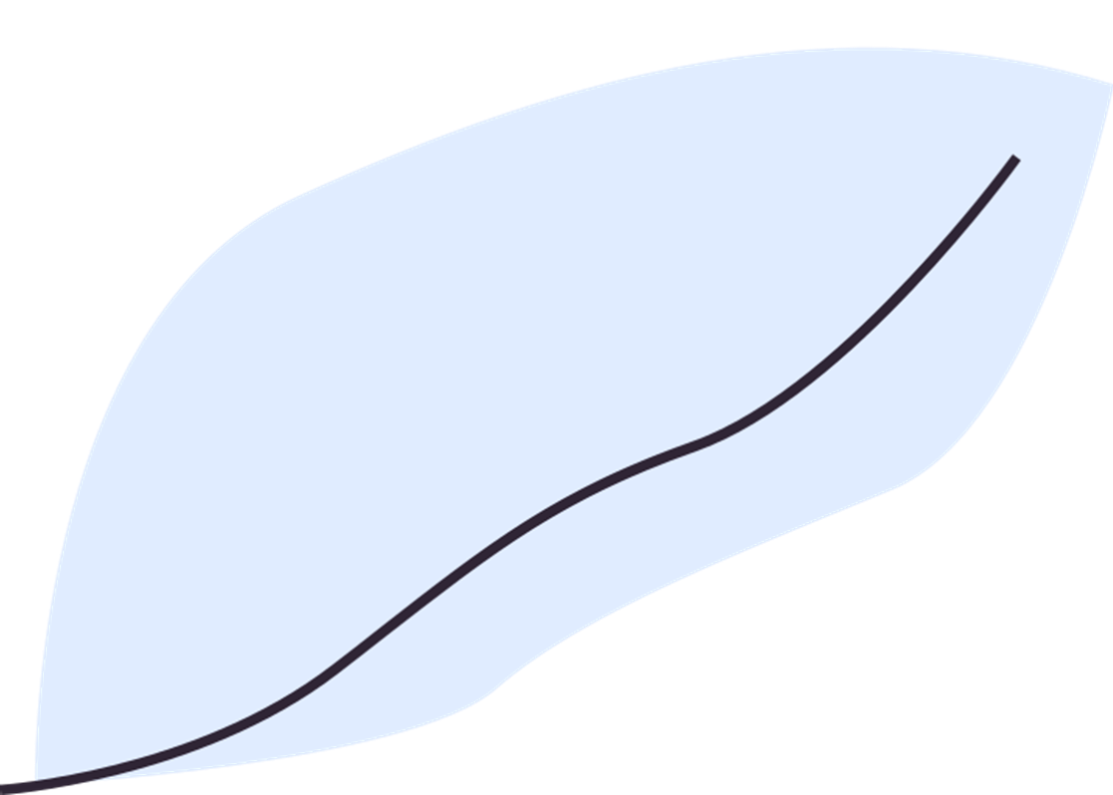


PROBLEM STATEMENT
World Health Organization
https://www.youtube.com/watch?v=zDx1LKkk5c4&t=186s
(Excerpt of the video -start 1.20 mins , end 1.46 mins)
Novel Covid-19 virus has made 2020 a memorable year.
The virus has impacted every aspect of life.
With the economic downturn and personal anxiety, some individuals have exhibited mental health issues.
Democrats and the Republicans proposed opposing views and practices to stem the spread of virus
Our project will prove or disprove the perspectives that:
States that have higher Covid-19 cases and deaths also exhibit a correlation to mental health
States political affiliation and the number of Covid- 19 cases and deaths are aligned with the key messages from:
o Democrats- wearing masks and social distancing will reduce the spread of the virus
o Republicans- wearing masks and social distancing are unnecessary. People should live like pre-Covid times and if necessary, take treatments for positive test instances rt

Slide 4
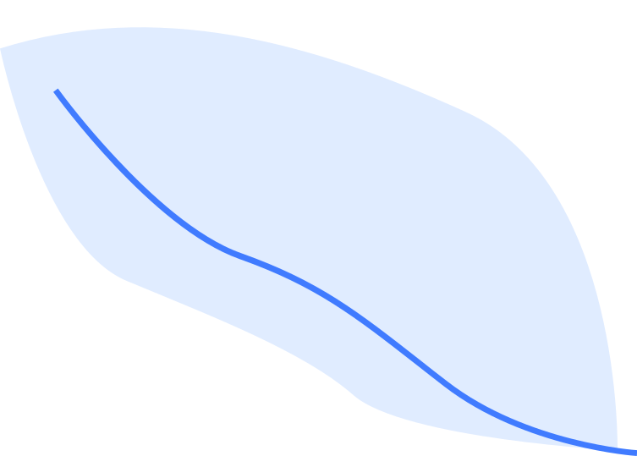
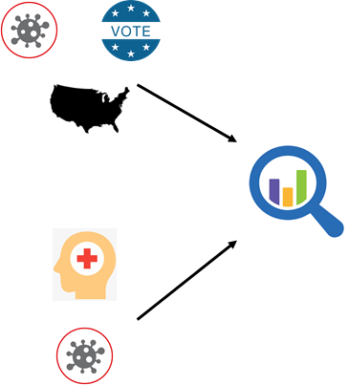
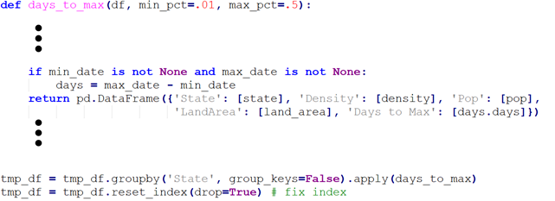
DATA CLEANSING
Data Acquisition
Covid Infections
Mental Health
Election Information
State Demographics
Feature Engineering
Joined Data Sets
Created Average Voting History
Normalized Covid Infections by Population
Data Aggregation
Aggregated at State Level
Created Custom Aggregation Function for Covid Data

Slide 5
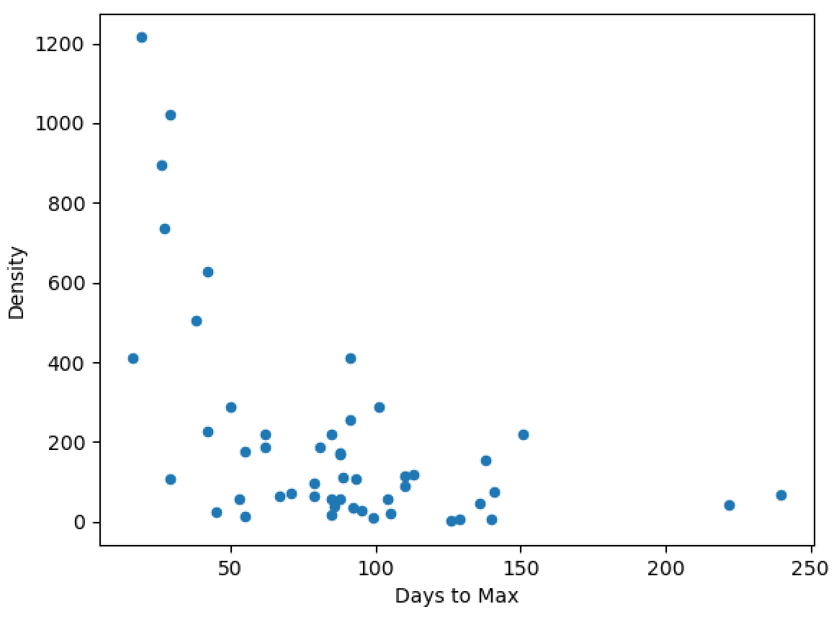
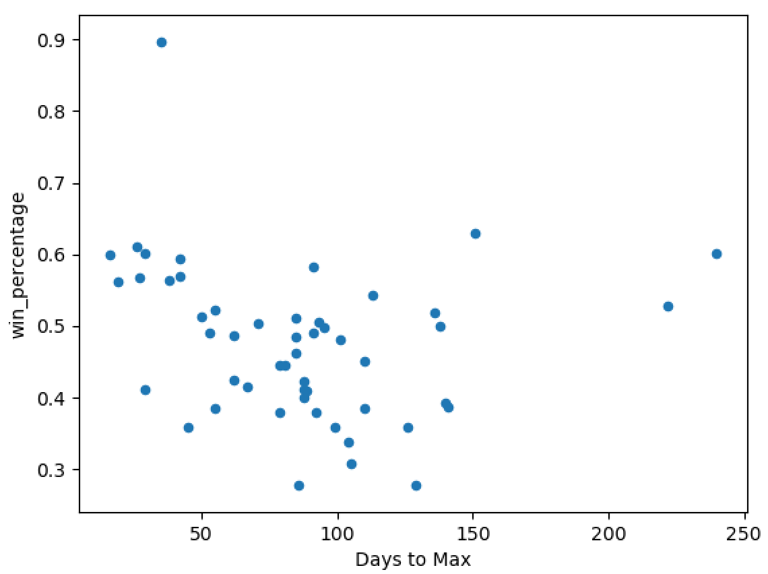
VISUAL
ONE
Scatter Plot Analysis of Days to Max
Comparing infection rates against population density showed a weak correlation while plotting against political affiliation showed almost no correlation.

Slide 6
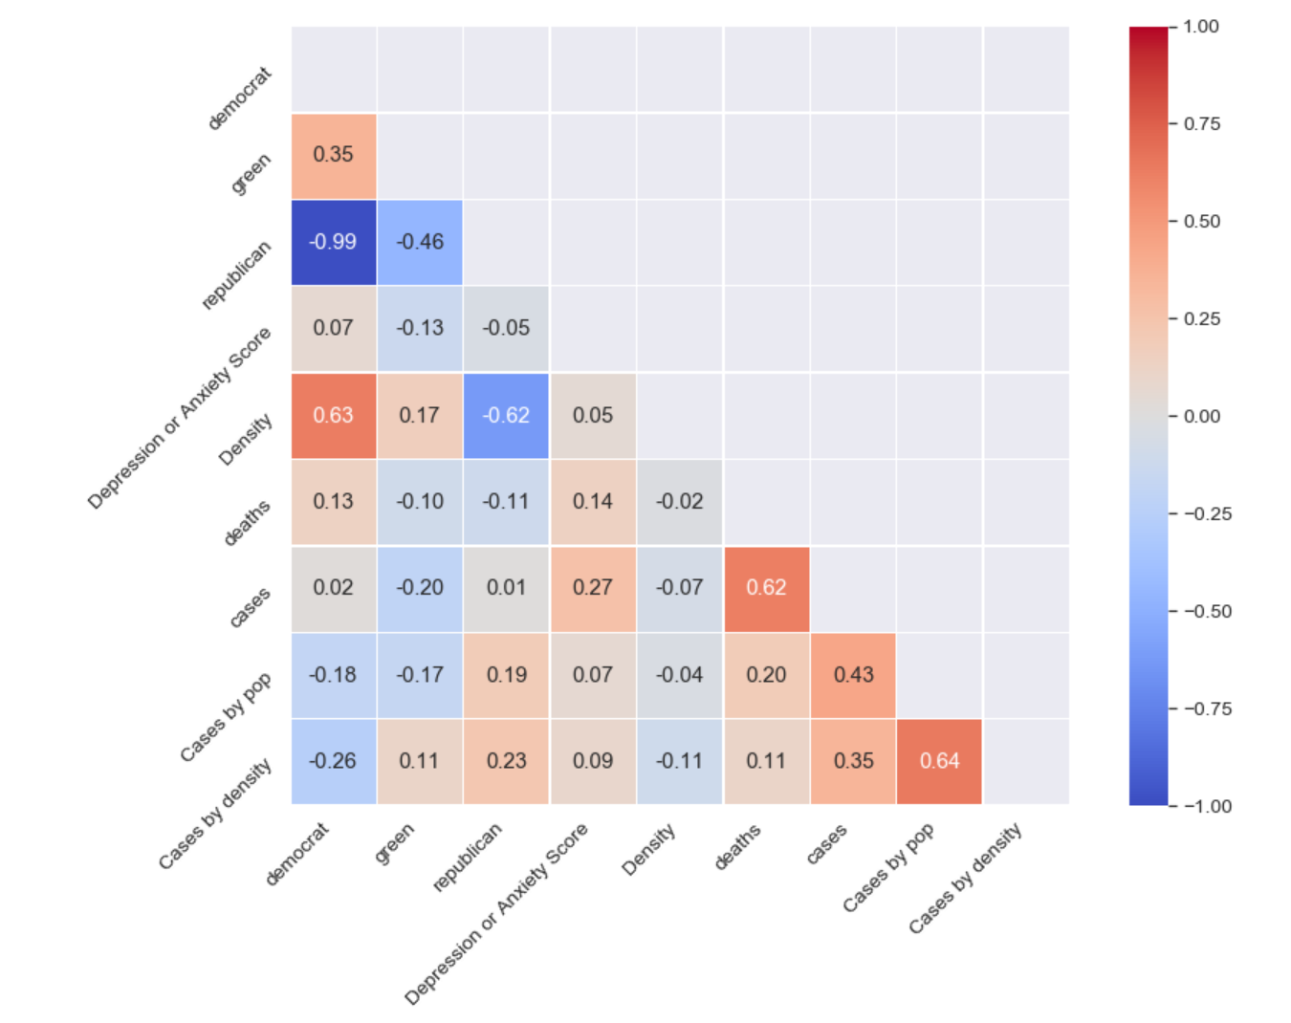
VISUAL
TWO
Correlation Plot
Weekly COVID cases have very low correlation to Symptoms of Anxiety or Depression
Normalized Weekly COVID cases also have low to no correlation to Symptoms of Anxiety or Depression
Notes:
Correlation heat map
1 is strong positive correlation adn -1 is strong negative correlation
Green arrow
Blue arrow
Red Arrow

Slide 7
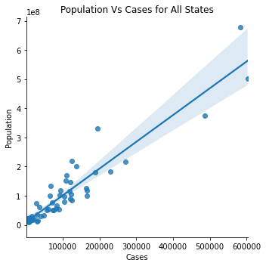
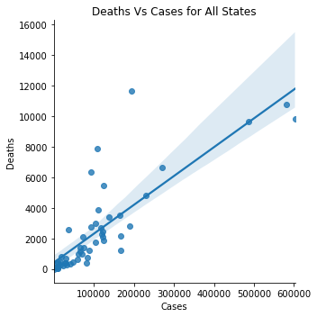
VISUAL
THREE
Scatter Plot Analysis by State
There is a direct correlation between the number of cases and the size of the population when looking at a state-by-state basis.
A higher number of cases is directly correlated to a higher number of deaths on a state-by-state basis.

Slide 8

FOR MORE INFORMATION
This has been Team Python
CIS 9650 Ali Koc
Fall 2020
Softwares Used
Python, Jupiter Notebooks and Github
Team Python
Karly Bland, David Lado, Debbie Banton, Jeffrey DeSoto, Daniel Huang, Cynthia Claudio
Notes:
It is no secret that COVID-19 has completely transformed life as we know it
We are now living in the new normal and
us humans ---> being the creatures of habit that we are,
can have trouble adapting to changes around us
That is why we thought it important to highlight the drivers and effects of a national pandemic on mental health, economics and political climate in our country
Every news station you look numbers and graphics are flashed across the screen but what are these numbers really telling you?
Our team didn’t just research scourges of data on the internet but we took great care cleansing our data to ensure accuracy and reliability
We used the data we had to create insights worth sharing and came to the conclusion that COVID-19 ...

